Slide 1
Self Service Publishing Project
Patrick Desbrow
Improve / Control Tollgate Review

Slide 2
BPM Project Summary
Problem Statement
As of December 2010, the [J. D. Power] Client System Group (CSG) spent approximately 22 hours or $2,000 to publish a single study on the existing Business Center web deliverable.
There were too many individual steps in a single study. The existing process was too manual and requires unnecessary IT staff to ensure accuracy.
In addition, the number of reported errors in the publishing process indicate potential issues with quality.
Defect Definition/Project Metric
D1: Labor Hours > $1,000
D2: # of Errors > 1
Objective
The aim of this project is to
Decrease the time by 50% or 11 hours of labor for a syndicated research study by April 2012.
Reduce the number of reported errors on a study to less than or equal to one.
Leverage standardization and automation.
Standardization allows us to do the same thing the same way which also allows for the automation of common tasks.
This will lower cost and allow for more research deliverables.
Projected Benefits
Based on a current project chargeback rate of $90 per hour, it is estimated that this project would remove $1,000 from a study.
With over 250 Syndicated studies published on the Business Center in 2011/2012, there is the potential for an estimated $250,000 savings each year.
The reduction of reported errors on each study will increase the overall quality of the study.

Slide 3
Project Roadmap
2007 vs. 2011
Syndicated Study Average
Then: 277 Hours (per study)
Now: 23 Hours
Future: 11 Hours
Out of Scope
In Scope
Then: 77 Hours
Now: 6 Hours
Future: 3 Hours
Then: 200 Hours
Now: 17 Hours
Future: 8 Hours
Essential Project Management
Hosting
BC QA Testing
Global Enhancements
Client Deliverables
Business-defined pain point
Gather Requirements
Load Data
Create Web Site Presentation
QA Web site
Project Management & Release Study
Then: 40 Hours
Now: 0 Hours
Future: 0 Hours
Then: 40 Hours
Now: 0 Hours
Future: 0 Hours
Then: 80 Hours
Now: 4 Hours
Future: 4 Hours
Then: 25 Hours
Now: 1.5 Hours
Future: .5 Hours
Then: 15 Hours
Now: 11.5 Hours
Future: 3.5 Hours
Next Priority
The focus for this project is the areas that where out of scope in the last BPM project. This includes the Study Release, Quality Assurance and the remaining Project Management tasks in the process.

Slide 4
Current State – Process Map
Planned Project Tasks for Project Management
IT PM sends status to research team
Update
issue log
Review study details on loading environment
Send update(s) to research team
Coordinate publishing tasks
Notify research when task(s) are completed
B
C
B
B
Planned Project Tasks for Study Release
7.0 Hrs (82%) of the time spent in project manager is non value added activities.
Dev team updates study tools based on the issue log
Attend study data publishing meeting
Move data content to production via auto tools
Notify project manager that when task(s) are completed
Load users / assign roles using tool
Notify project manager that when task(s) are completed
A
B
B
1.0 Hrs (67%) of the time spent in Quality Assurance is non value added activities.
Planned Project Tasks for Quality Assurance
1.0 Hrs (33%) of the time spent in study release is non value added activities.
Attend study data publishing meeting
Review study tools on loading environment
Report defects to project manager
Review study tools on production
Review users / assign roles on production
Notify project manager that when task(s) are completed
A
C
B
Forms of Waste
(Non Value Added Activities)
A
There are a number of areas for improvement
The highlighted boxes emphasize the need for a new process and new tools that support automation.
Processing
B
Motion
C
Defects

Slide 5
Future State – Process Map
Planned Project Tasks for Project Management
RT sends email reminder to research team
Update
issue log
RT sends update(s) to research team
Coordinate publishing tasks
RT send update when task(s) are completed
B
Planned Project Tasks for Study Release
7.0 Hrs (82%) of the time spent in project manager has been removed from the process.
Dev team updates study tools based on the issue log
Update
status in RT
Move data content to production via auto tools
Update
status in RT
Load users / assign roles using tool
Update
status in RT
1.0 Hrs (67%) of the time spent in QA has been removed fro the process.
1.0 Hrs (33%) of the time spent in study release has been removed from the process.
Planned Project Tasks for Quality Assurance
View study work queue
in RT
Review study tools on loading environment
Update defects in RT
Review study tools on production
Review users / assign roles on production
Update
status in RT
Forms of Waste
(Non Value Added Activities)
A
There are a number of areas that were improved
The highlighted boxes emphasize the change to a new process
Processing
B
Motion
C
Defects

Slide 6
Improve Findings
Labor hour can be removed
  Goal 1: Project management tasks (7.0 hours, an 82% reduction)
  Goal 2: Study release process (1.0 Hour, a 33% reduction
  Goal 3: Quality assurance steps (1.0 Hour, a 67% reduction)
Other drivers of waste
  Goal 4: Other General / Setup tasks (2.0 Hours, a 33% reduction)
Total Saving Potential: 11.0
This was accomplished with a 5 recommended changes to the current process.
Two agile development sprints were completed in the first quarter of 2012.

Slide 7
Agreed Upon Recommendations
Goal: Develop the necessary tools that researchers can use to eliminate or reduce the manual steps to publish client deliverables*
Improvement Tasks | Owner | Due Date** | Status**
Self Service Publishing - Web Site Recommendations Develop project statement of work Create a detailed project plan RT Web site Update – Sprint 1 Web Site Auditing and Validation RT Web site Update – Sprint 2 Web Site Auditing and Validation Client sign off BPM Control Phase/Handoff | IT Project Manager IT Project Manager Technology Team Research Team Technology Team Research Team Cathie Baker BPM Team | 11/30/2012 11/30/2012 01/05/2012 01/12/2012 02/01/2012 02/15/2012 04/01/2012 06/01/2012 | Completed Completed Completed Completed Completed Completed Completed In Progress

Slide 8
Recommendations
Sprint 1 / Recommendation 1 (R1):
Current: IT managers meet with research teams to discuss the process steps and collect key dates in the publishing schedule.
Recommendation: Replace meetings with a new tab in Research Tool (RT) to collect and store dates.
In addition, a online sit preparation checklist could be added to ensure all of the RT steps are understood.
Sprint 1 / Recommendation 2 (R2):
Current: Research teams update a global master publishing schedule in MS Excel.
Recommendation: Replace the global master publishing schedule with the same tool in RT (above).
Sprint 1 / Recommendation 3 (R3):
Current: IT manager sends emails to the research team when key events take place in the publishing process.
Recommendation: RT already sends email alerts. These alerts can be extended to the publishing process as well.
Sprint 2 / Recommendation 4 (R4):
Current: IT manager maintains offline metrics and reports around the process.
Recommendation: Move the offline metrics and reports into RT and create a management dashboard.
Sprint 3 / Recommendation 5 (R5):
Current: User permissions are loaded to the Business Center using a combination of manual and automated steps.
Recommendation: Automate the remain steps in the user administration tool and site QA process.

Slide 9
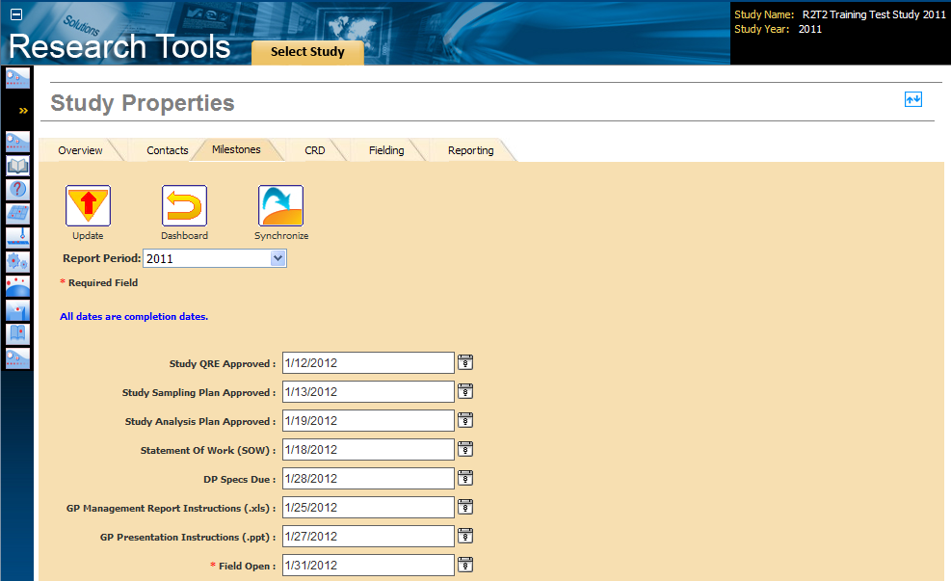
Research Tools Enhancements Recommentations
R1/R2: Replace meetings with a new tab in Research Tool (RT) to collect and store dates. In addition, a online sit preparation checklist could be added to ensure all of the RT steps are understood.
Status: The update Study Properties page now includes a checklist and key milestone dates. These additions have reduced the need to for meeting, emails and other redundant communication tasks.

Slide 10
Research Tools Enhancements Recommentations
R3: RT already sends email alerts. These alerts can be extended to the publishing process as well.
Status: The RT alerts have been extended to the Study Properties and Publishing feature. Researchers are now notified when their study dates changed and when the study is published.
Sample Email:
From: ResearchTools@jdpa.com
To: Research Day to Day Manager@jdpa.com
Subject: Study 1234: Status Update
Body:
Greetings,
  Study 1234 - Study Name: The Processing Step is completed.
  Please login to the site to move to the next step: http://businesscenterloading.jdpower.com/ResearchTools.aspx
Regards,
JDPA Research Tools (RT)

Slide 11
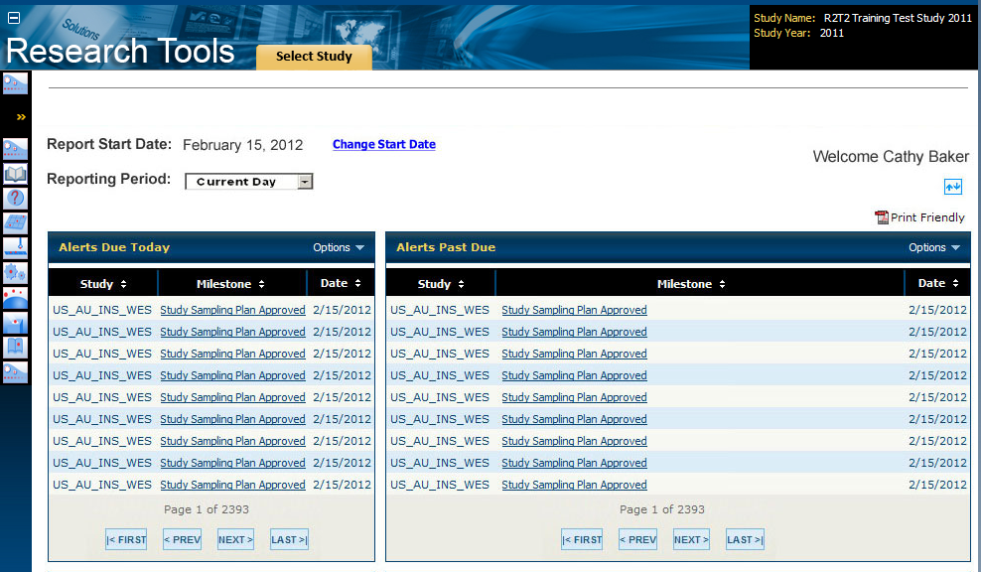
Research Tools Enhancements Recommentations
R4: Move the offline metrics and reports into RT and create a management dashboard.
Status: The new management dashboard These additions have reduced the need to for meeting, emails and other redundant communication tasks.

Slide 12
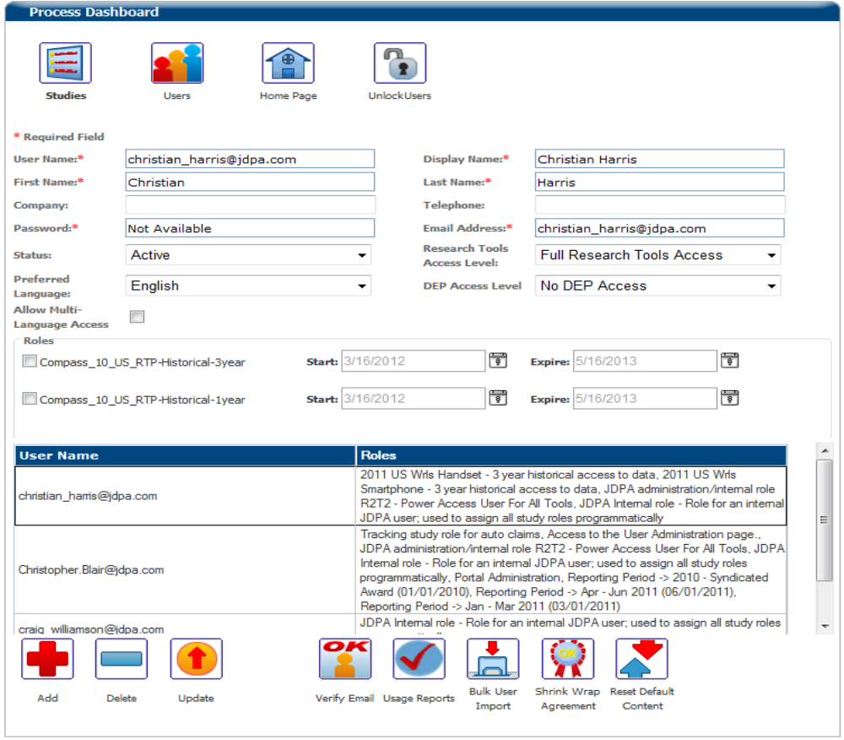
Research Tools Enhancements Recommentations
R5: User permissions are loaded to the Business Center using a combination of manual & automated steps.
Status : The RT user administration process has been automated and the QA process has been streamlined.

Slide 13
Communication/Training Plan
Training for Business Center and the Research Tools
  Training materials have been developed
  The training class was piloted in early February 2012
  All researcher & technologist that work on studies will participate in training
  CSG project managers have worked with research to aid in the transition
  A support team is in place for the remainder of the year
  A development team will focus on enhancements and bug fixes
Communicate Plan
  Global Research (GRO) created a set of communications promoting the value of the tool and the availability of training
  Robert Dalton will conduct quarterly meetings to highlight the features of the tool
  Cathie Baker performed training and communication on the research side
Establish and communicate improvements across JDPA
  Ensure that all research new hires have a RT orientation as part of the training
  All training and communication tasks should be completed by August 2012

Slide 14
Control Plan
Ensure the new self service publishing process reduce labor costs while maintaining quality for all the syndicated studies in the JDPA Business Center environment.
Monitor the overall CSG labor hours (Target: 11 hours or $1,000 per study)
  Project Management
  Quality Assurance
  Study Release Process
Monitor the number of quality related errors that occur on the project (Target: < 1 errors)
  Number of issues report by the research team after the study was released
Data collection and monitoring
  Robert Dalton will be the process owner for this project going forward
  Project labor hours are already extracted from the time keeping system monthly
  Robert Dalton will continue to track the number of quality related issues that occurred on each study
  This data collected as part of the existing charge back process.
  A project scorecard will be populated on a monthly dashboard

Slide 15
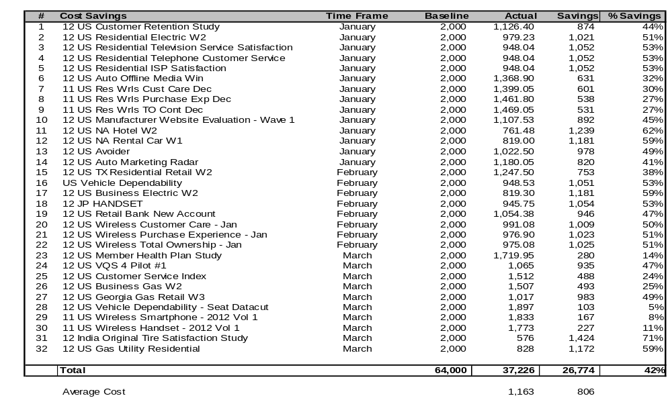
Project Benefits
32 studies where executed in early 2012. As a result, there was a total of $26,774 or 42% saving across these studies. This is an average cost of $1,163 per study.
Source: Full labor hours capture through Timepiece. Contract labor hours captured through ActTime

Slide 16
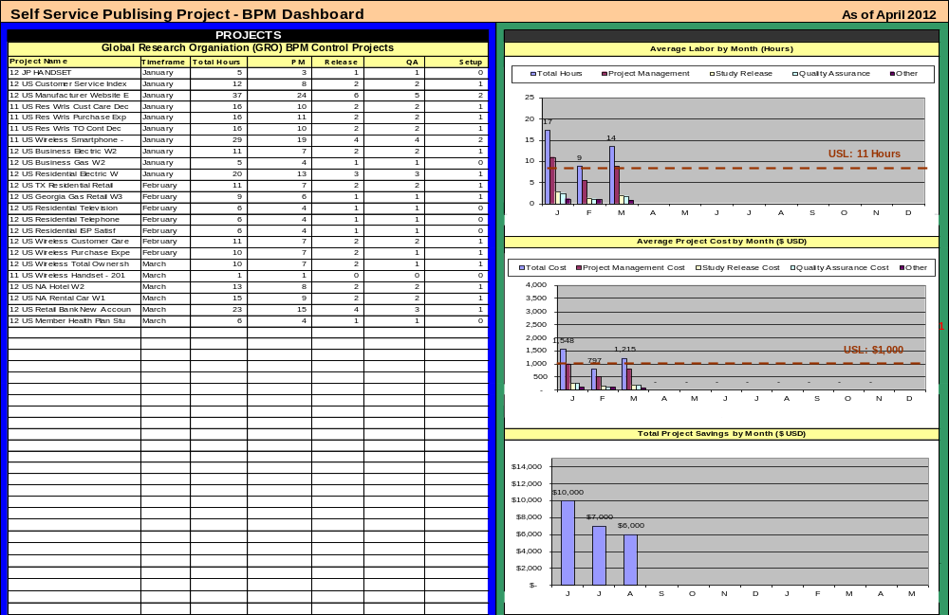
Scorecard Example

Slide 17
Audit Plan
Audit Objective:
Measure the effectiveness of the improvements of the new Self Service Publishing process for all the syndicated studies in the JDPA Business Center environment.
  Labor/process improvement associated with recent enhancements of the research tool
  Number of quality related errors that occur on the project
Audit Date: August 2012
Responsibility: Robert Dalton / Eric Crudo
Deliverable: Audit report presented to Jonathan Miller

Slide 18
APPENDIX

Slide 19
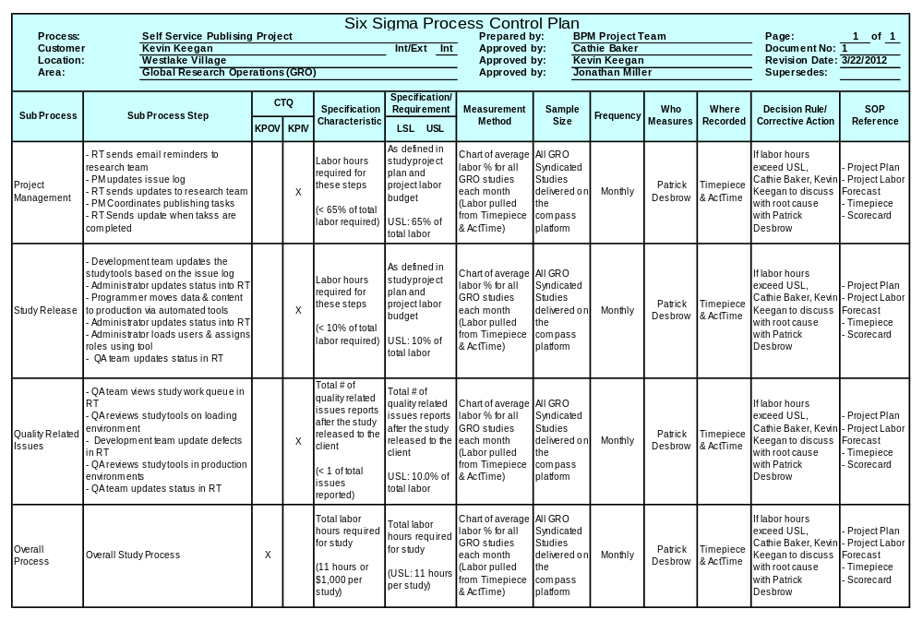
Control Plan Details

